Slide 1
Nuclear Power
Sofía Ramírez
Hannah Ashworth
Federico Madrigal

Slide 2
What is it?
The process of generation nuclear power starts with the mining and processing of uranium and other radioactive elements.
These elements are used to feed the reactor of a nuclear power plant, generating a reaction known as fission which creates intense heat, turning water in the plant into steam.
The steam powers steam turbines, which generate electricity and feed the electricity into the electrical grid.

Slide 3
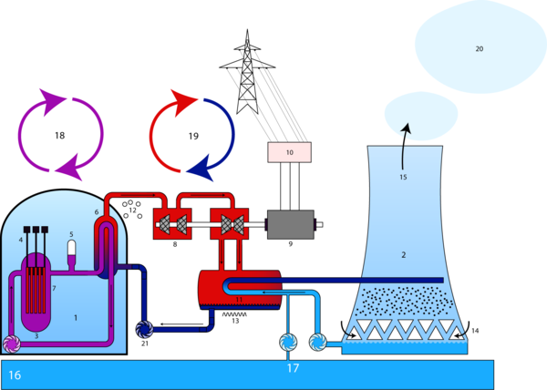

Slide 4
PROS | CONS
A clean way to produce energy as it does not result in the emission of any of the poisonous gases like carbon dioxide, sulfur dioxide or nitrogen dioxide. | Radiation, causing cancer.
Nuclear waste is not only small in quantity but also does not affect anyone in its surrounding. | Safety for example-Chernobyl and Three Mile Island.
Waste of nuclear power is much easier because it is just dumped in to a geological site where it decays over a period of time and has no negative impact on the ecosystem. | Waste- while it decays releases radiation.
Eco friendly. | Accidents due to core meltdown.
Extremely reliable, uranium is abundant on the Earth’s crust. | Costs, over 3 to 5 billion dollars to create a nuclear power plant, maintenance, etc.
Supported by many ecological organizations and environmentalists. | Weapons, make enough plutonium to build over 30 nuclear bombs.
It is possible to generate a high amount of electrical energy in one single plant. | Relies only on uranium.

Slide 5
Problems (Chernobyl)
Chernobyl is a small town in the Ukraine near the Belarus border
The explosion spewed radioactive particles into the air. Everything local from health to agriculture was effected by the radiation
The radioactivity affected all the world, especially Europe.
Contaminaded crops and caused birth deformities

Slide 6
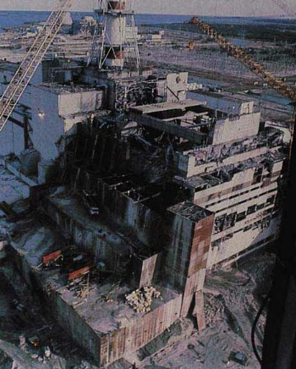

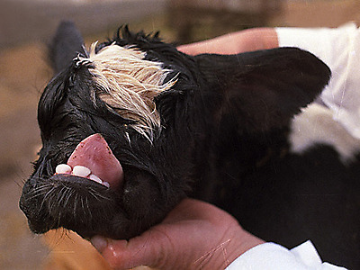

Slide 7
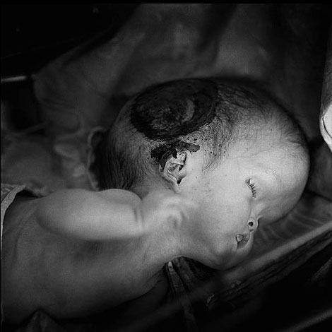
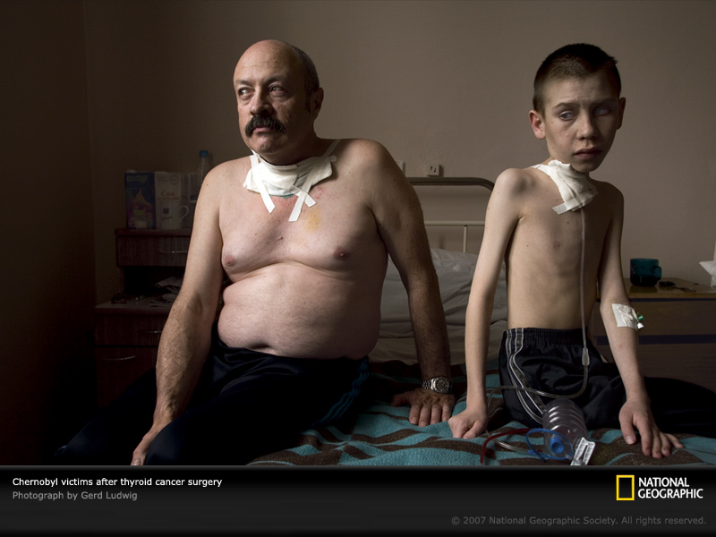

Slide 8
Where is it used?
France, Belgium, Hungary, Lithuania, Slovakia, South Korea, Sweden, Switzerland, Slovenia, Ukraine
Japan, Germany, Finland, USA

Slide 9
The Future…of this industry
Research of nuclear fuel cycle continues in the present
Experts predict electricity shortages, fossil fuel price increases and global warming will renew the demand for nuclear power.
During 1980S one nuclear reactor was started every 17 days, in 2015 this rate will increase to 1on every 5 days.

Slide 10
Worries about safety justified?
We consider that the benefits outlaw the worries.
There has been only two mayor incidents.
Its very unlikely for accidents to happen.
There has been more frequent accidents using other types of renewable energy, such as mining and bird being killed by wind power turbines.

